Slide 1


GLOBAL ACADEMY OF TECHNOLOGY
DEPARTMENT OF CSE
DBMS MINI PROJECT
BLOOD BANK DATABASE MANAGEMENT SYSTEM
Submitted By:
PAVITHRA K TANTRY 1GA18CS189
NISHA BHAT BALANJA 1GA18CS192
Under the Guidance of
Mrs. Reshma S
Assistant Professor
Dept. of CSE

Slide 2
ABSTRACT
A blood bank is a center where blood gathered as a result of blood donation is stored and preserved for later use in blood transfusion. The term “blood bank” typically refers to a division of a hospital where the storage of blood products occurs and where proper testing is performed. The main aim of the blood bank management system is to help people who are in need of blood by giving them all details of blood group availability or regarding the donors with the same blood group.
This project aims at maintaining all the information pertaining to blood donors, different blood groups available in each blood bank and helping them manage in a better way. It also provides transparency in this field, makes the process of obtaining blood from a blood bank hassle free and effective.

Slide 3
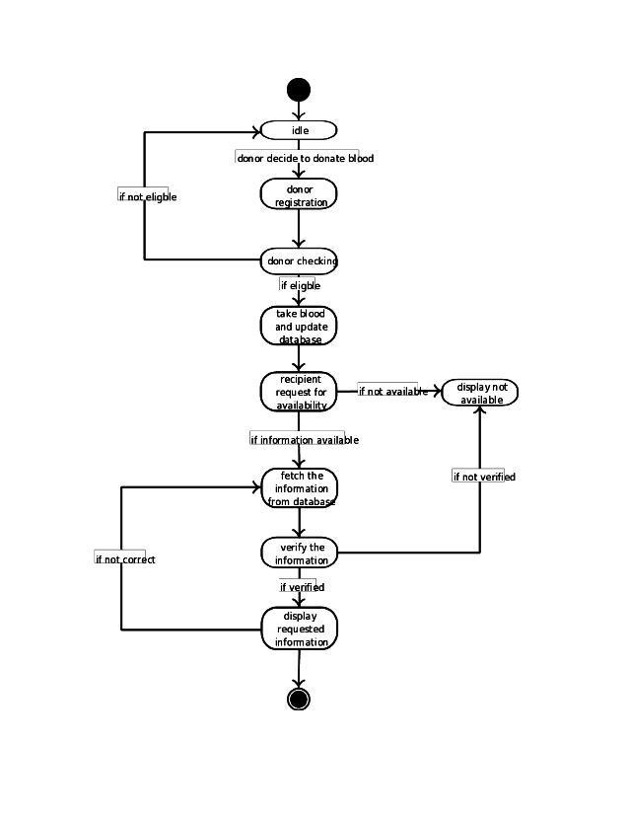
BLOCK DIAGRAM

Slide 4
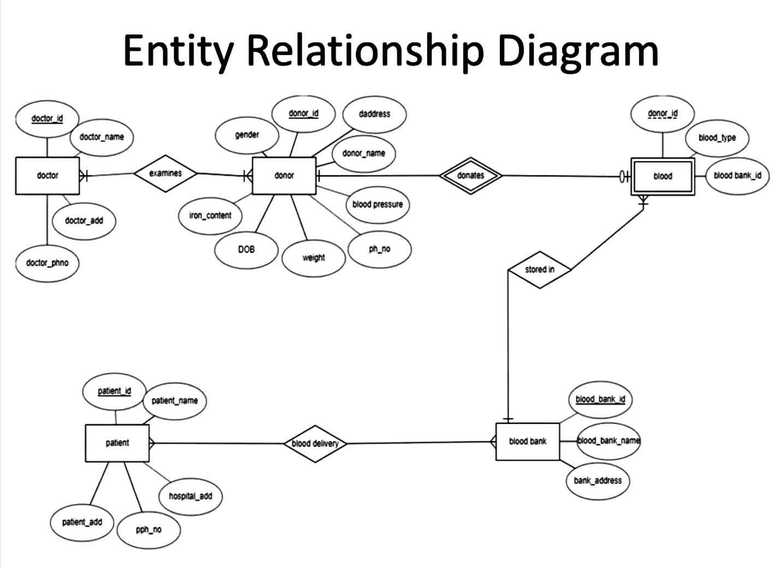
M
N
1
1
M
1
M
N

Slide 5
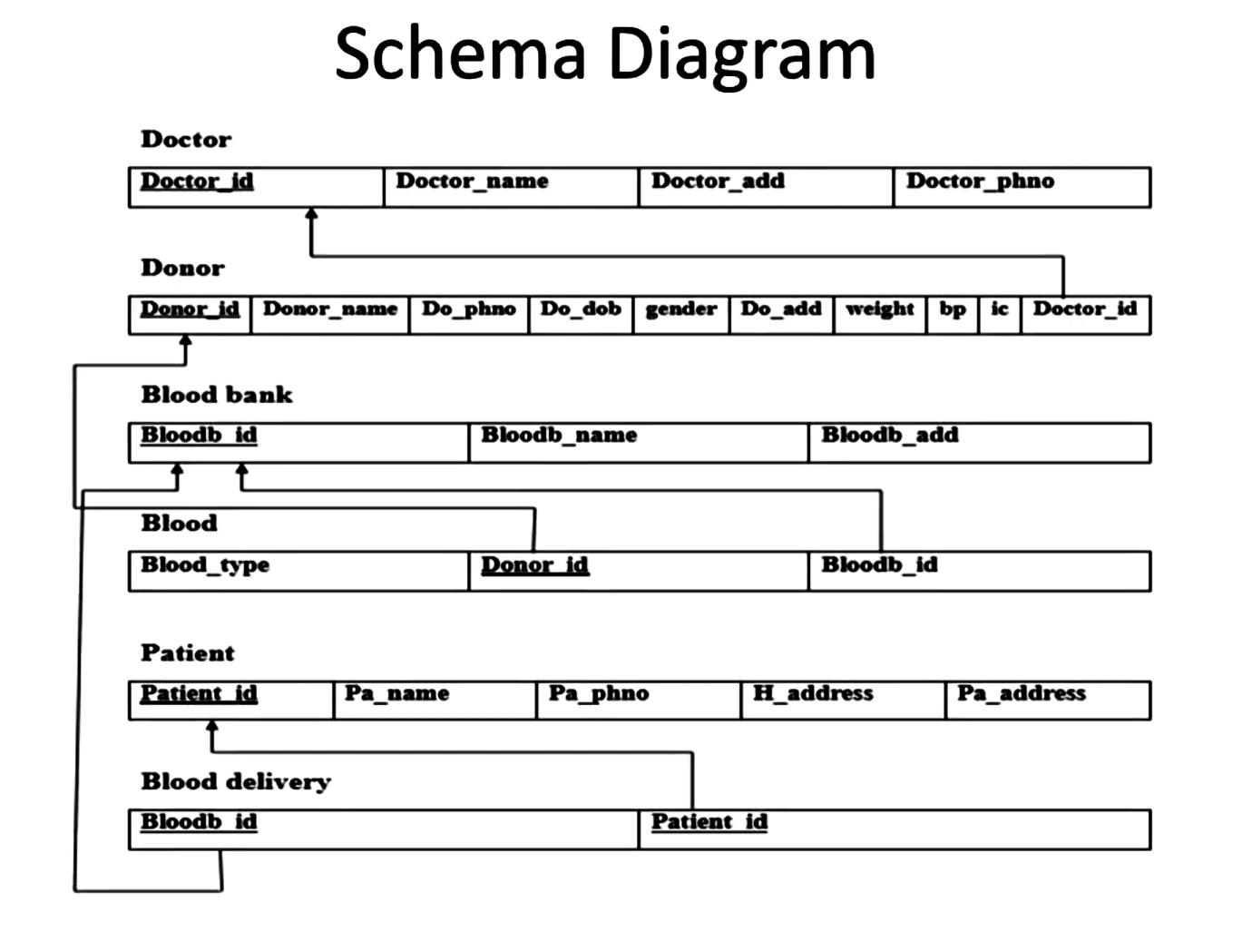

Slide 6
REFERENCES
Fundamentals of Database Systems, Ramez Elmasri and Shamkant B. Navathe, 7th Edition, 2017,Pearson.
Database management systems, Ramakrishnan, and Gehrke, 3rd Edition, 2014, McGraw Hill
https://stackoverflow.com/
https://www.w3schools.com/
https://www.php.net/

Slide 7
THANK YOU

